Slide 1
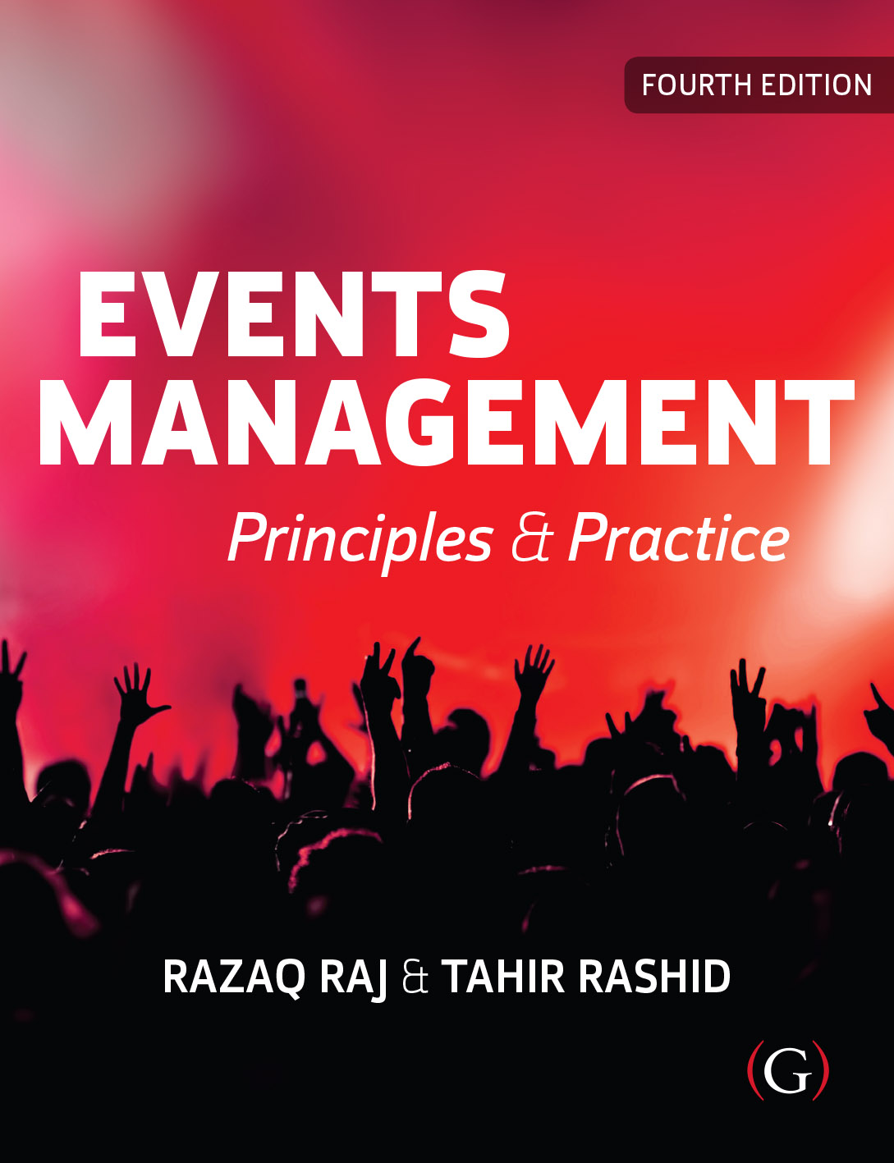
Events Management: Principles & Practice, 4th Edition
By Razaq Raj and Tahir Rashid

Slide 2
Chapter 15
Event Production, Design and Lighting
These are some bullet points:
The chapter has identified and provided a practical guide for events staff to understand the lighting design use of visual production technology.
It is important lighting design that being used at the live events meets the health and safety standards and meet the attendee’s satisfaction by using 3D technology equipment.
Lighting design plays vital role in enhancing the spectators experience who attend live events and festivals.

Slide 3
Event Production Management
The production management plays key role running the event, planning of the event, organising entertainment and managing the sound and lighting equipment of the event.
The production team is predominantly dealing with entertainment side of the event and festival and implementation of the event.
The production is responsible for taking care of the event production equipment.
Responsible for completing health and safety forms.

Slide 4
Event Production Management
Event production team is responsible for the following vital equipment.
  Event Lighting
  Event PA Sound system
  Electrical power
  Staging of Event
  Video screening of event
  Managing multiple event stages for larger events
  Monitor System and microphones

Slide 5
Live Events Health and Safety Standards
Production management team responsible for health and safety standards are met according to following UK and European regulations.
  The Health Protection (Coronavirus, Restrictions) (England) (No. 3) Regulations 2020
  Control of Major Accident Hazards (COMAH) Regulations 2015
  Licensing Act 2003
  Management of Health and Safety at Work Regulations 1999
  Health and Safety at Work Act 1974 (HSWA)

Slide 6
Event Production Team and Safety Advisory Group (SAG)
The Health and Safety Executives (HSE) have recommended the event organiser should work with local authority Safety Advisory Group (SAG).
SAGs are set up by the local authority (LA) and made up of representatives from all emergency services, key stakeholders and event organiser.
The SAGs are based within each local authority boundaries.
SAGs help event organisers with the site production, health and safety, planning, security and cooperation and between appropriate agencies.

Slide 7
Birmingham local authority Safety Advisory Group (SAG). The SAG is chaired by the local authority.
  Local Authority
  West Midlands Police Service
  West Midlands Fire Service
  West Midlands Ambulance Service
  Event Organiser
  Licence Holder
  Security provider
  Medical provider
  Other stakeholders
  The SAG is chaired by the local authority

Slide 8
Erection of Temporary Demountable Structures
Department of Communities and Local Government and the Institutions of Structural and Civil Engineers (2017) has issued guideline for event industry to follow use of temporary demountable structures such as:
  Stage structures
  Marquees
  Grandstands for sport events
  Temporary Barriers
  Towers and Masts for Media facilities
  Lighting Towers

Slide 9
Temporary Demountable Structures
Temporary structure check list.
  Site Structure drawings
  Full calculations of temporary structure capacity
  Design loads of temporary structure
  Relevant test results being carried at site
  Risk assessments covering the design and erection
  Safety method declaration of site
  Completion certificate of temporary structure

Slide 10
Lighting and Sound System
The lighting and sound system is one of the key areas of the event and festival industry.
sound system is required need meet the safety and noise requirements.
HSE Control of Noise at Work Regulations 2005.
Rigorous methods in place to manage the sounds and lights systems

Slide 11
Lighting and Sound System
The event organiser should have event co-ordination team on site to make smooth running of event site and check that suppliers and contractors are using specific and tested sound and lighting.
Smooth communication between onsite contractors and workers of smoothly run of the event with breaching any legal requirements.
It is essential for the event organisers to have quality PA system, lighting, staging and truss production in place for visitors enjoying and boost their experiences.

Slide 12
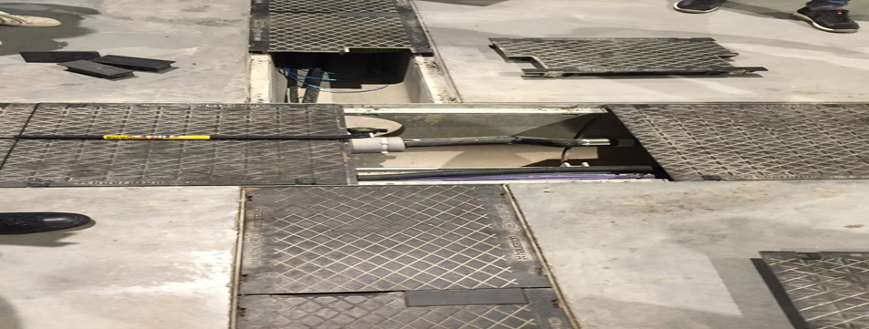
Wiring Lights and PA System at Yorkshire Event Centre

Slide 13
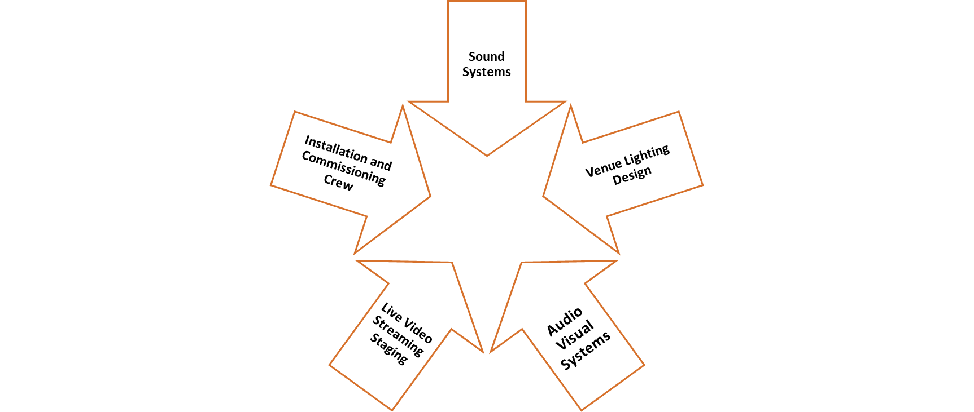
Live Event Sound and Lights Phases

Slide 14
Summary
The responsibility of the production team to verify that all staging, lighting, sound system, videos screens, wireless communication, power distribution and all other key technical equipment able to deliver to high quality to enhance the experience of event attendees.
It is important contractors and suppliers should have safety records of lighting that are being provided for the event and it is responsibility of the event organisers to check, if the lightings that are being installed conform to regulations.
All electrical equipment brought to onsite by the contractors should be meet the safety stand-ards and are in good condition.

